Slide 1
Status Review
18.12.2017

Slide 2
Last week:
Tried to build a mathematical model for coil arrangement
According to HEX-Script from RWTH and VDI-Heat Atlas
Found a method to define a test plan for practical testing and evaluation
Design of Experiment

Slide 3
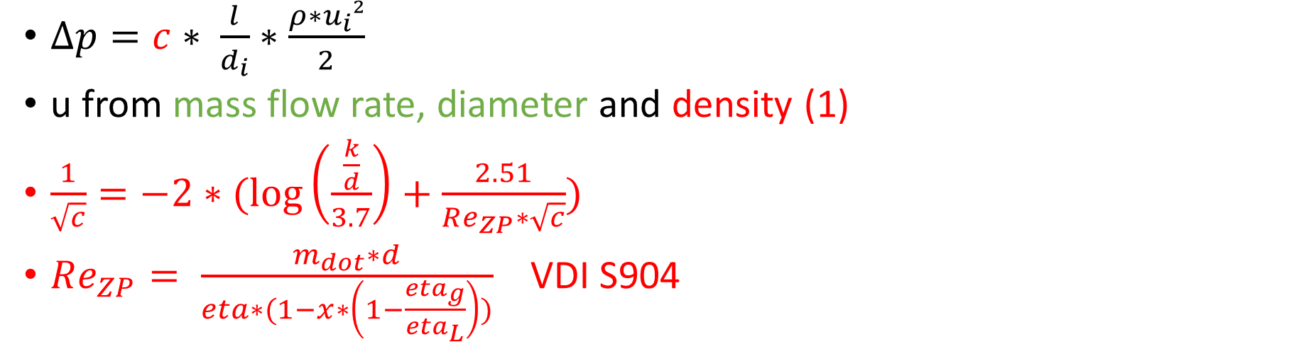
Pressure fall -> Fall of evaporating temp.
P1
P2
T_{sat,1}
T_{sat,2}
C_{p}
$∆p=c∗ \frac{l}{d_{i}}∗\frac{ρ∗u_{i}²}{2}$
u from mass flow rate, diameter and density (1)
$\frac{1}{\sqrt{c}}=−2∗(\log\left(\frac{\frac{k}{d}}{3.7}\right)+\frac{2.51}{Re_{ZP}∗\sqrt{c}})$
$Re_{ZP}= \frac{m_{dot}∗d}{eta∗(1−x∗\left(1−\frac{eta_{g}}{eta_{L}}\right))}$ VDI S904

Slide 4
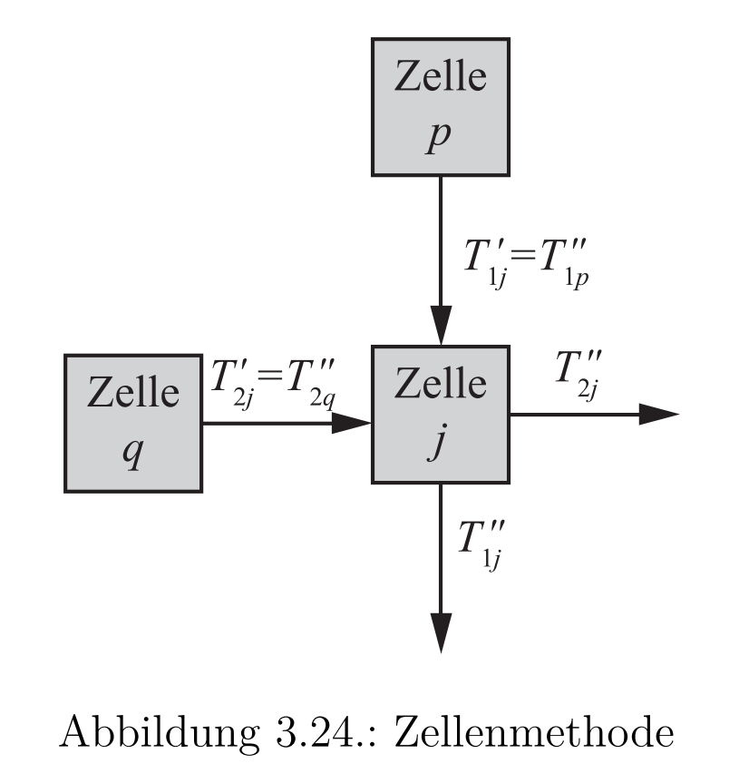
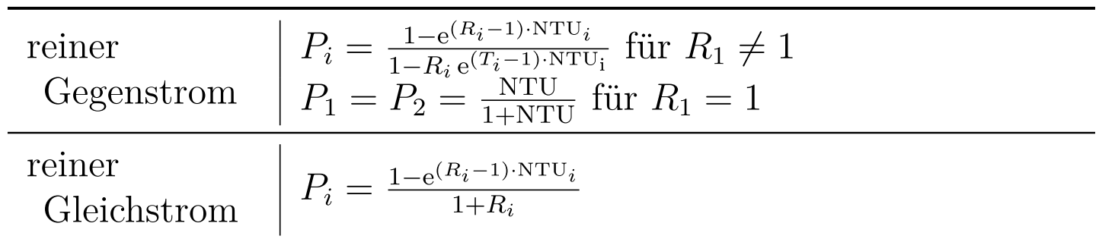
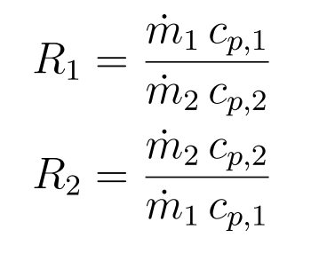
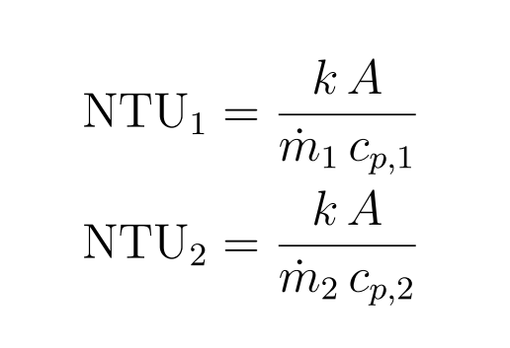
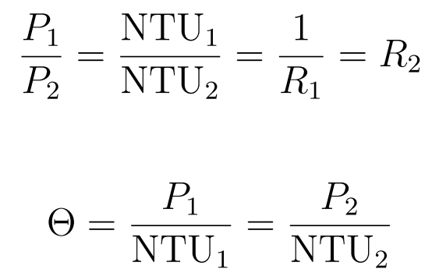
Cell method
Heat capacity flow rate ratio:
← Air
← Refr
← Thermal conductivity
kA(material), c_{P}(P,T) → R₁ , NTU → P → T_{out} → Q

Slide 5
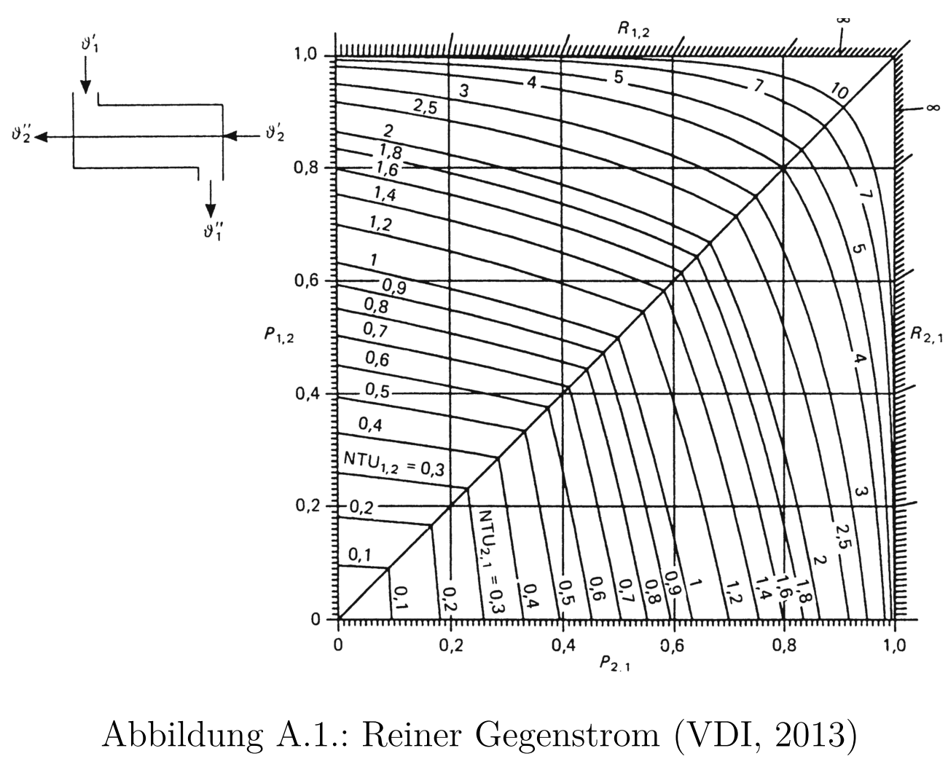
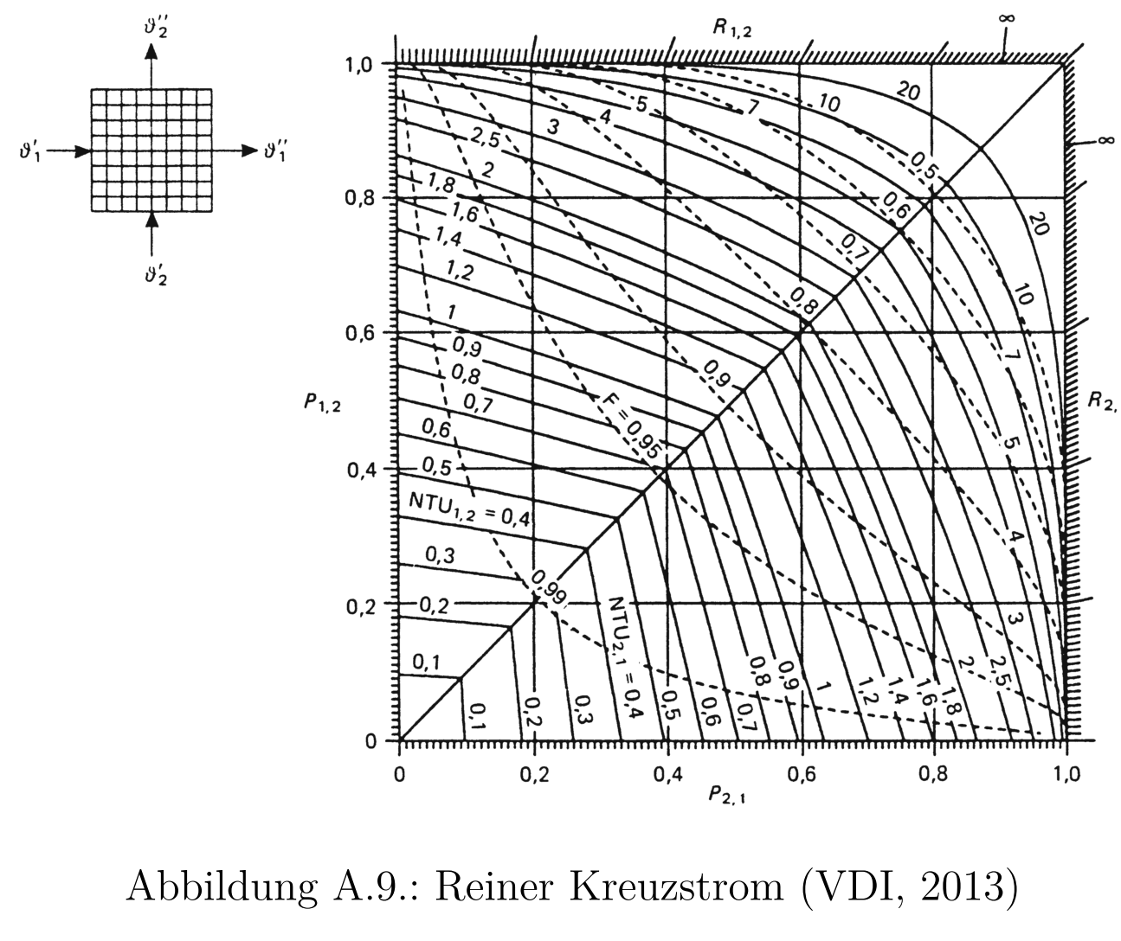
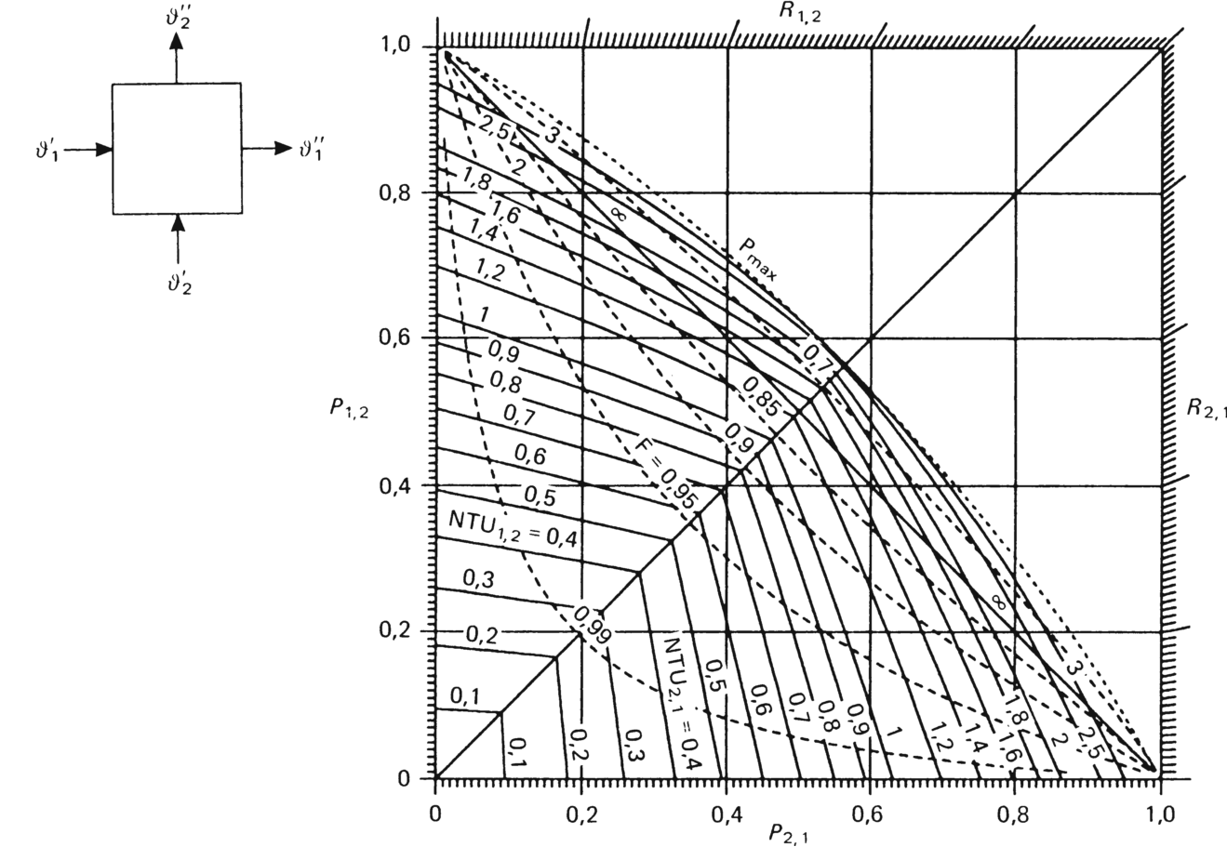
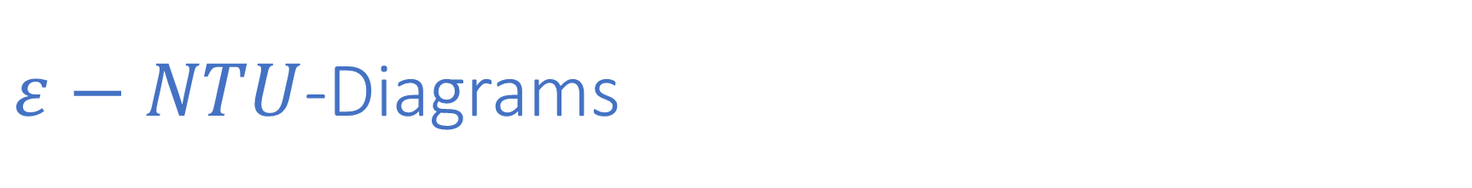
$ε−NTU$-Diagrams

Slide 6
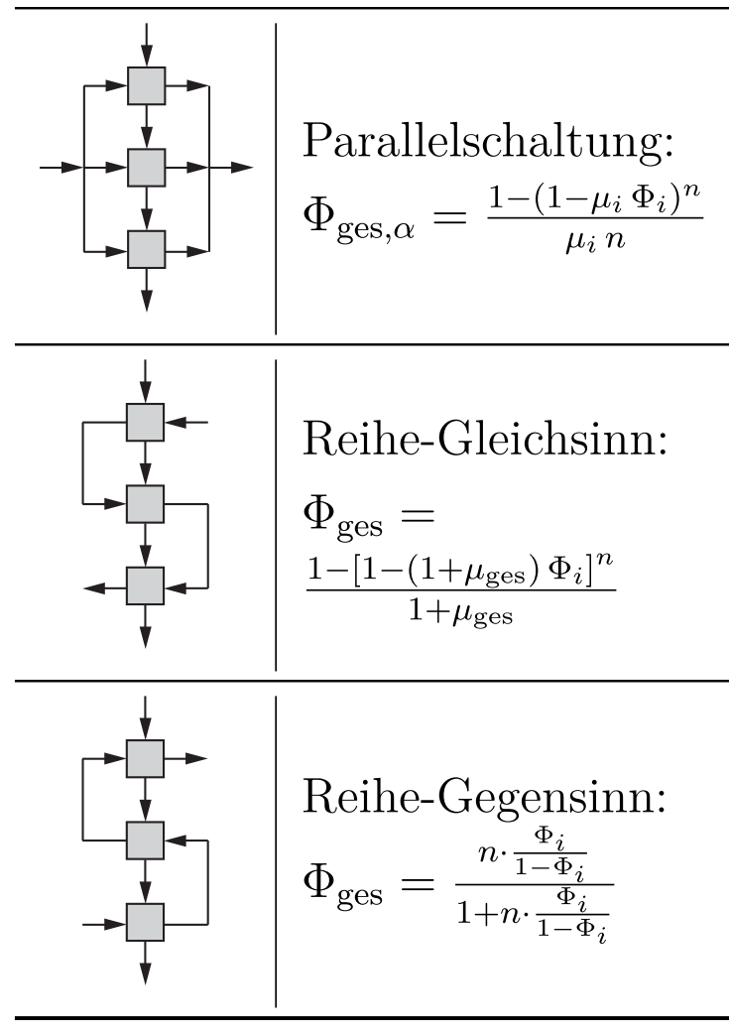
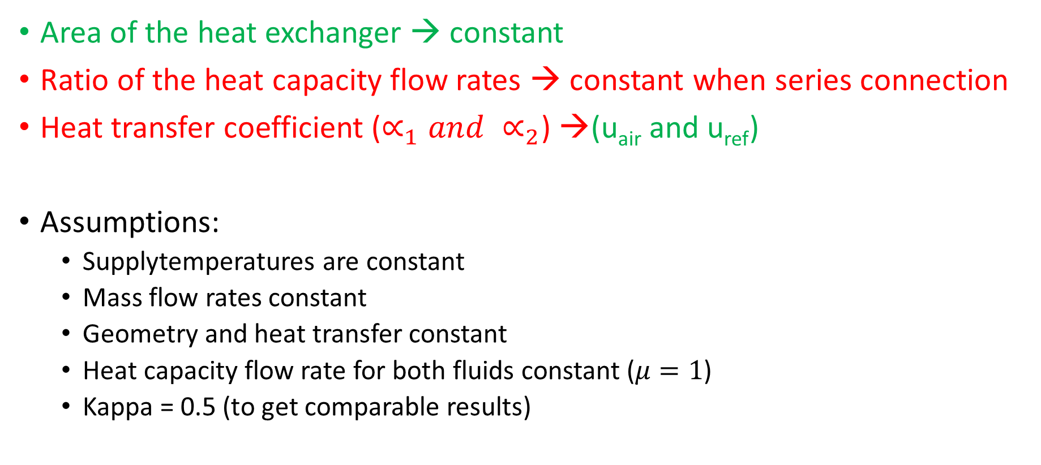

Determination of single performance characterisation $φ$
Area of the heat exchanger → constant
Ratio of the heat capacity flow rates → constant when series connection
Heat transfer coefficient ($∝_{1}and ∝_{2}$) →(u_{air} and u_{ref})
Assumptions:
Supplytemperatures are constant
Mass flow rates constant
Geometry and heat transfer constant
Heat capacity flow rate for both fluids constant ($μ=1$)
Kappa = 0.5 (to get comparable results)

Slide 7
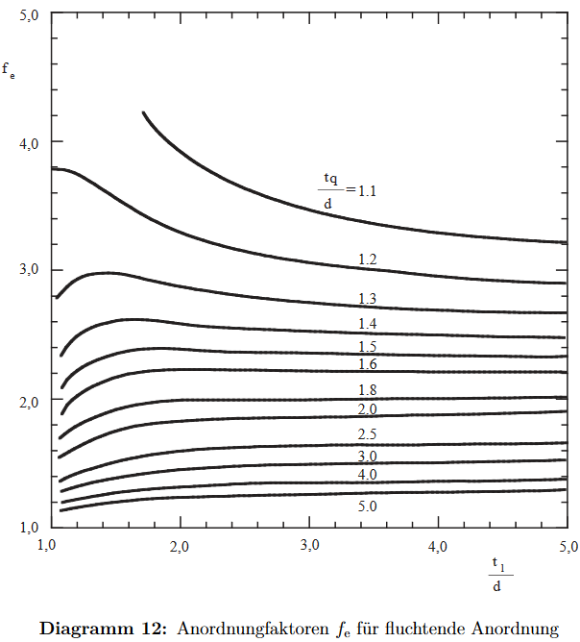
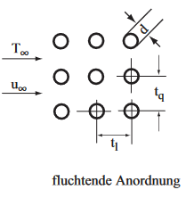




Air side
→ Alpha for Convection

Slide 8
To-Do:
Connect this partial models
Impact of boiling (→ alpha)
Impact of phase (→ moving boundary or discretization and phase check)
Impact of fins?

